Slide 1
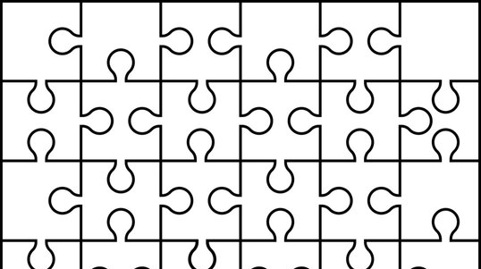
My Solution
Álvaro Vega Romero
Done for the technical challenge in Aircury

Slide 2
Way proceeded
Read patiently the exercise. Make notes
Disconnect from the computer & Brainstorm
“Implement” a solution on paper
Choose Programming Language
Manage input and output
Implement an algorithm for solving the Puzzle
Iterate over it to get a better solution (New ideas Fixes, Testing, Refactor…)

Slide 3
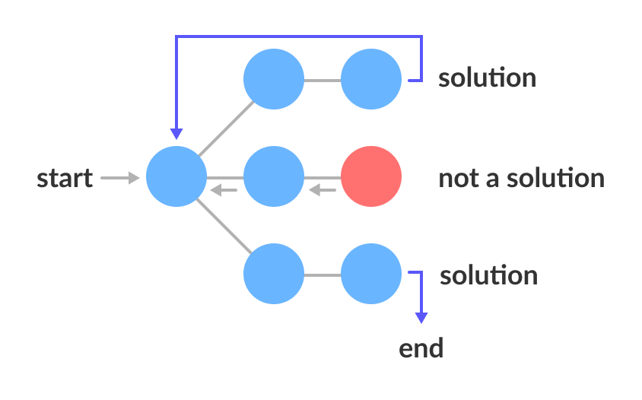
Algorithm: Backtracking

Slide 4
Implementation
Create Board & Pieces
Try to place every Piece with all the orientation
If the piece fits, make a recursive call with the remaining pieces in a different position.
If you can’t continue, go back
If you have all the pieces placed → Possible Solution
If the solution is not a rotation of the current solution, save it

Slide 5
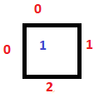

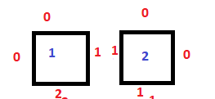
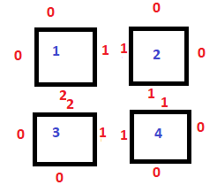
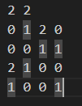
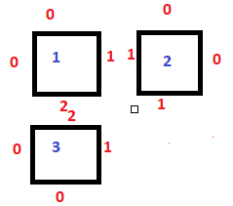
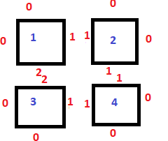
Easy Example in 2x2 Puzzle
1. Try piece 1 in (0,0)
Pieces and Sides
Representation
2. Try piece 2 in (0,1)
3. Try piece 3 in (1,0)
4. Try piece 4 in (1,1)
5. ALL PIECES PLACED → Possible Solution
6. Solution is not a rotation of another. SAVE SOLUTION

Slide 6
Improvements
More efficiency. Reduce Real Complexity (O(n!))
Heuristic on how to solve. Maybe start with corners, then borders…
Pruning (if we are not able to go into a acceptable solution)
Avoid the creation of remaining pieces in every recursive call
Use SET (Data Structure) for the Pieces. (O(1) in default operations)
…
Process of determining the solution was good

Slide 7
Time Spent in Task
Around 6h (Coding) + 1h (Presentantion) Part-time
(but not very efficiently because of the Heat and family)

